Slide 1
Sentiment Analysis using Deep Learning
[BERT Model]

Slide 2
Contents
Title
Problem statement
Literature Survey
Proof of concept/ Methodology/ Design Diagrams (DFD, ERD, USE CASE etc.)
Coding and Testing of the project
Result

Slide 3
Problem Statement
With the increasing reliance on online platforms for communication, understanding emotional expression in digital spaces has become critical. However, emotional patterns and sentiment trends often go unnoticed, leading to challenges in detecting shifts in public sentiment, potential mental health concerns, or online harassment. There is a need for a data-driven solution that accurately identifies and analyses emotional patterns across various digital platforms, enabling more empathetic, safer, and responsive online experiences. This project seeks to bridge the gap by leveraging sentiment analysis and machine learning to interpret and visualize evolving emotional trends in real-time.

Slide 4
Literature Survey
Title of the paper | Author(s) | Pros | Cons | Datasets Used
[1]Cyberbullying Detection on Twitter Using NLP and ML Techniques Link: ​journals.tultech.eu | Stephen Afrifa, Vijayakumar Varadarajan (2022) | Uses ML models (Random Forest, SVM) to detect cyberbullying with 98.5% accuracy. | Limited to Twitter, struggles with sarcasm/slang, lacks multilingual support & real-time analysis. | 16,851 tweets from Twitter.
[2]Cyberbullying Detection on Twitter Using Sentiment Analysis Link: journal.esrgroups.org | Sandip Bankar, Surekha Janrao, Preeti Gupta, Rohini Patil, Mansi Nandkar, Avantika Jalote, Karim Sohail Khan, Kevin Ninan Mathew (2024) | Uses sentiment analysis (TF-IDF, SVM), achieves 92.98% accuracy. | Focuses only on Twitter, doesn’t handle multimodal content (images, GIFs), lacks explainability. | Twitter dataset (specifics not mentioned).
[3]Comparative Sentiment Analysis of Techniques for Cyberbullying Detection on Twitter Link: su-plus.strathmore.edu | Victor Otieno Kanam (2020) | Compares various ML models for cyberbullying detection. | Mostly focuses on evaluation rather than proposing new techniques. | Twitter dataset (specifics not mentioned).
[4]Sentiment Aided Cyberbullying Detection with Explanation Link: arxiv.org/abs/2401.09023 | Krishanu Maity, Prince Jha, Raghav Jain, Sriparna Saha, Pushpak Bhattacharyya (2024) | Introduces an explainable AI model for cyberbullying detection in code-mixed languages. | Dataset is still limited, lacks large-scale real-time testing. | "BullyExplain" dataset (multilingual cyberbullying data).

Slide 5
Literature Survey
Title of the paper | Author(s) | Pros | Cons | Datasets Used
[5]Machine Learning based Approach for Detection of Cyberbullying Tweets Link: https://doi.org/10.5120/ijca2020920946 | Shah, R., Aparajit, S., Chopdekar, R., & Patil, R.(2021) | Effective use of supervised ML algorithms with decent accuracy | Performance impacted by slang, short-text ambiguity, and sarcasm | Various early Twitter datasets.
[6]Deep learning approach to detect cyberbullying on Twitter Link:https://doi.org/10.1007/s11042-024-19869-3 | Aliyeva, Ç. O., & Yağanoğlu, M. (2024) | Provides high accuracy with neural networks and scalable architecture | Struggles with generalization across domains and noisy data | Various ML datasets (not specified).
[7]Cyberbullying detection on Twitter using machine learning algorithms Link: https://doi.org/10.1063/5.0217132 | Chaitanya, A. N. V., Prateek, T. S. S., Varun, P. V. A., Rohit, P. T., & Uma Maheshwari, K. M. (2024) | Reviews sentiment analysis techniques and their applications, discusses linguistic resources. | Focuses more on methodology rather than real-world implementation or cyberbullying detection. | Multiple sentiment analysis datasets (not specified).

Slide 6
Methodology
1. Methodological Steps
Step 1: Data Collection
Sentiment140 Dataset: Download the Sentiment140 dataset, which contains labeled tweets (positive, negative, neutral).
Preprocessing: Clean and preprocess the dataset by removing unnecessary data like stopwords, special characters, and irrelevant information to prepare the data for analysis.
Step 2: Data Exploration and Preprocessing
Text Tokenization: Break down the text data into smaller units (tokens) for analysis.
Vectorization: Convert text data into numerical form using techniques like TF-IDF or Word2Vec to enable machine learning models to interpret the text.
Label Encoding: Encode sentiment labels (positive, negative, neutral) into numerical values for model training.

Slide 7
Methodology
Step 3: Model Development
Sentiment Analysis Model: Train a machine learning model, such as Logistic Regression, SVM, or Naive Bayes, using the preprocessed dataset to predict the sentiment of new text inputs.
Emotion Detection: Use libraries like TextBlob or VADER to detect underlying emotions (e.g., joy, sadness, anger) from the text.
Model Evaluation: Evaluate the model using metrics like accuracy, precision, recall, and F1 score to assess its performance.
Step 4: Sentiment Analysis and Trend Identification
Analysis of Trends: Apply the trained sentiment analysis model to analyze large sets of text data, categorizing them into sentiment labels and tracking sentiment trends over time.
Topic-wise Sentiment Analysis: Perform sentiment analysis on specific topics or events to understand public opinion and emotional reactions.
Time-Series Analysis: Study sentiment shifts over time to identify correlations with real-world events.

Slide 8
Methodology
Step 5: Visualization and Interpretation
Graphical Visualization: Use tools like Matplotlib and Seaborn to visualize sentiment distribution, emotion trends, and changes over time.
Sentiment Trend Graphs: Plot sentiment trends across various topics or timeframes, allowing for easy interpretation of shifts in public sentiment.
Word Clouds: Create word clouds to show the most frequently mentioned terms in different sentiment categories.
Step 6: Result Interpretation
Insight Generation: Analyze the results to draw insights about the topics being discussed, the emotional state of the online community, and any potential mental health or harassment concerns based on sentiment patterns.
Reporting: Document findings and trends in a comprehensive report, offering actionable insights or recommendations.

Slide 9
Methodology
2. Expected Outcomes
Clear sentiment categorization of text data (positive, negative, neutral).
Identification of emotional trends or patterns in public discourse.
Understanding of public reactions to specific topics or events.
Insights into the potential mental health impact or signs of online harassment.
3. Success Criteria
Accuracy: High accuracy of sentiment classification, with a goal of achieving 85% or higher accuracy.
Trends Identification: Ability to detect clear shifts in sentiment over time or in relation to specific events.
Insight Quality: The ability to generate meaningful insights from sentiment analysis and correlate them with real-world issues.
User Satisfaction: Clear, understandable visualizations and reports that help stakeholders understand sentiment shifts and their implications.

Slide 10
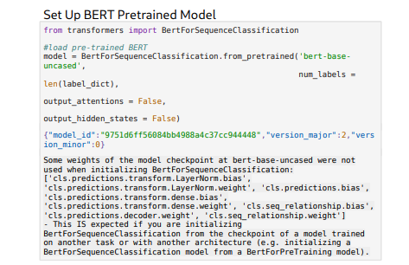
Coding and Testing

Slide 11
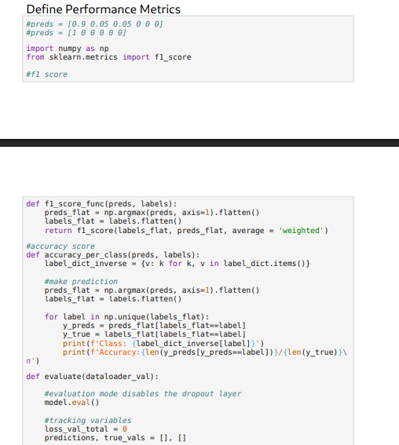
Coding and Testing

Slide 12
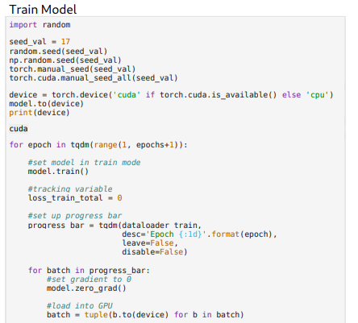
Coding and Testing

Slide 13
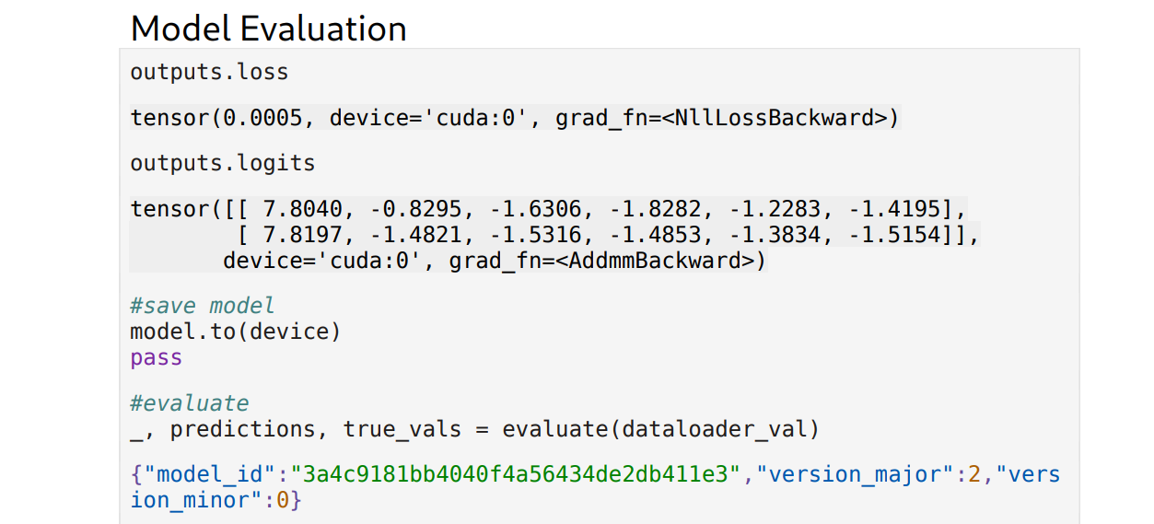
Coding and Testing

Slide 14
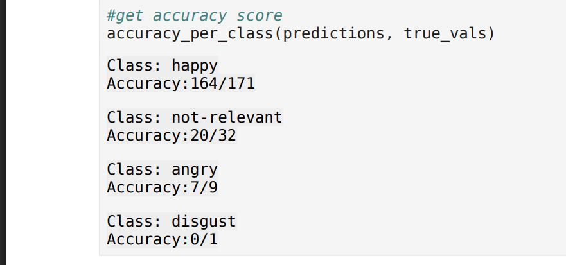
Coding and Testing

Slide 15
Result
The training of BERT (Bidirectional Encoder Representations from Transformers) took around 11 minutes per epoch (for a total of 4 epochs) on GPU per algorithm, since the transformers parameters (more than 100 million) have been fine tuned to perform the best on the given dataset.
Performance Metrics:
Weighted F1 Score: 86%
Class-wise Accuracy:
Happy: 164 / 171 → 95.9%
Not-relevant: 20 / 32 → 62.5%
Angry: 7 / 9 → 77.8%
Disgust: 0 / 1 → 0%
Sad: 2 / 5 → 40%
Surprise: 2 / 5 → 40%

Slide 16
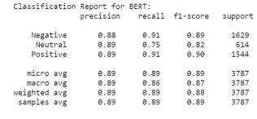
Result

